Slide 1
Event Driven Architecture
“Store the Change not the Value”
Notes:
Welcome, I'll explain and demo event sourcing in software applications.
I’m going to break down event sourcing into simple terms.
Issue is it is often presented in a way that seems overly complex, but at its core, it’s actually quite straightforward.
Sometimes, the fancy terminology surrounding event sourcing can be a barrier to understanding.
So, I am going to strip away that jargon for now and focus on the essence.
Once the concept is clear, we’ll bring the terminology back in.
Event sourcing is an approach for tracking changes to application state, stored as a sequence of events.
Each change is associated with an event, which contains the timestamp and nature of the specific change.
It makes investigations a breeze,
allows you to understand what happened and in what order, and
guides business decisions with precise analytical information.

Slide 2
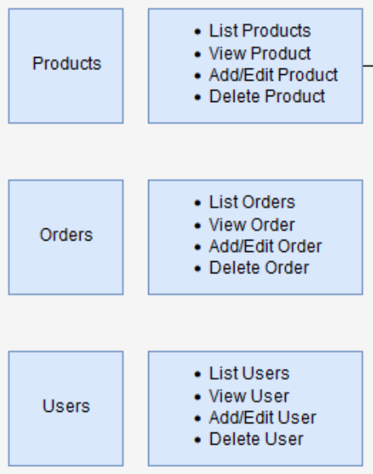
CRUD limitations
The traditional create, read, update, and delete (CRUD) model
CRUD is all about persistence of Data ( A Repository Pattern)
CRUD approach is for the application to maintain the current state of the persistent data by updating it as users work with it.
CRUD process is to read data from the store, make some modifications to it, and update the current state of the data with the new values—often by using transactions that lock the data.
The CRUD approach has some limitations:
CRUD systems perform update operations directly against a data store.
These operations can slow down performance and responsiveness and can limit scalability, due to the processing overhead it requires.
In a collaborative domain with many concurrent users, data update conflicts are more likely because the update operations take place on a single item of data.
Unless there's another auditing mechanism that records the details of each operation in a separate log, history is lost.
With CRUD - Timeline, Auditing and Dashboard metrics are hard.
Notes:
The problem in a nutshell: CRUD is about technology – but very few applications are created to solve technological problems. Instead, software is usually written to solve real-world domain problems. The complexity inherent in the respective domain lies in its matter of subject, which can hardly be comprehensively described with a handful of verbs, the arbitrary restriction of one’s own language to just four verbs (create, read, update, delete),
In addition, there is the loss of the entire history and the regular destruction of data through UPDATE and DELETE statements. Both are devastating for a later evaluation of business processes, since important findings can no longer be gained, as the way in which data is generated can no longer be traced.
The really biggest drawback of event sourcing has not yet been mentioned: Very few developers are familiar with event sourcing. CRUD has been known to practically everyone forever, which is why the use of event sourcing means that you have to leave your beloved comfort zone. You will win massively, but you first have to experience this gain to realize that it is worth the effort.
If you use event sourcing for a while, for example in connection with CQRS and domain-driven design (DDD), the use of UPDATE and DELETE suddenly seems to be completely wrong, and you wonder how you could ever work with CRUD, and believe that you have a suitable data model in front of you.
It’s Time to Rethink Event Sourcing

Slide 3
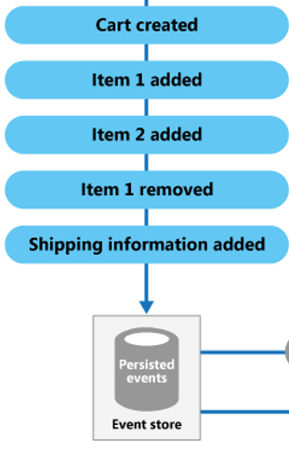
Event Sourcing - Intent, Purpose, or Reason
The Event Sourcing pattern defines an approach to handling operations on data that's driven by a sequence of events, each of which is recorded in an append-only store.
Application code sends a series of events that imperatively describe each action that has occurred on the data to the event store, where they're persisted.
Each Event represents a set of changes to the data (such as AddedItemToOrder).
Event Sourcing captures intent, purpose, or reason
As opposed to CRUD (Create, Read, Update & Delete) which describes storage mechanisms.
For example, changes to a customer entity can be captured as a series of specific event types, such as Moved home, Closed account, or Deceased.
Notes:
Event sourcing also has several drawbacks:
It is a different and unfamiliar style of programming and so there is a learning curve.
The event store is difficult to query since it requires typical queries to reconstruct the state of the business entities. That is likely to be complex and inefficient.
As a result, the application must use Command Query Responsibility Segregation (CQRS) to separate read and write queries. This in turn means that applications must handle eventually consistent data.
online transaction processing (OLTP) systems, their main use case is to fetch an aggregate from persistence, perform a command/action on it i.e. order.ship(trackingNumber) and save the new event.
event sourcing is relatively simple: a storage for events is required, which only time and support adding and reading events. It is therefore a so-called append-only data store.
Event Sourcing - EDA is often considered the "holy grail" of system design.
Transient flaw debugging: If a bug can be reproduced, it can be fixed. The nasty bugs are the ones that only happen every once in a while
Blinded to the obvious because of one of my successes with CRUD and Observability, but scaling aggressive instrumentation has slowed apps to an unusable state.
Event sourcing turns an application into a batch process, with all the attendant benefits for quality control and debugging. Replay and rerunning business logic.
So rather than performing risky manual data adjustments, you can fix the code and replay the event stream, allowing the system to recalculate values correctly based on the new code version.
Its nice to see a problem clearly in its entirety for the first time and know exactly how to address it.
The Promised Land of Event Sourcing - The Honest Coder

Slide 4
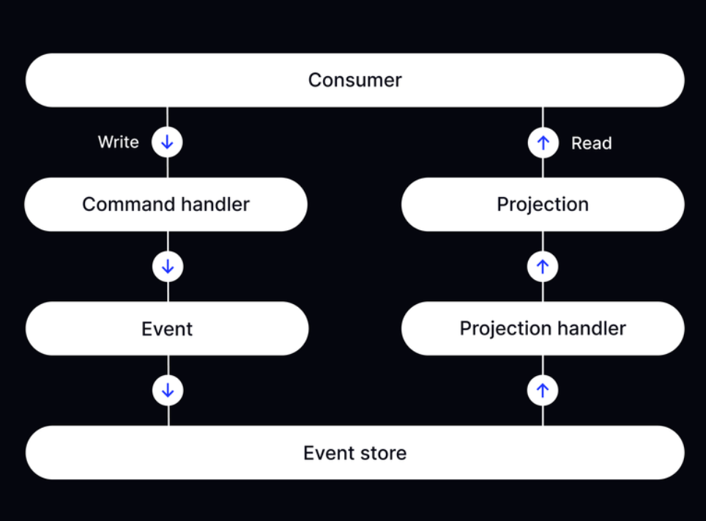
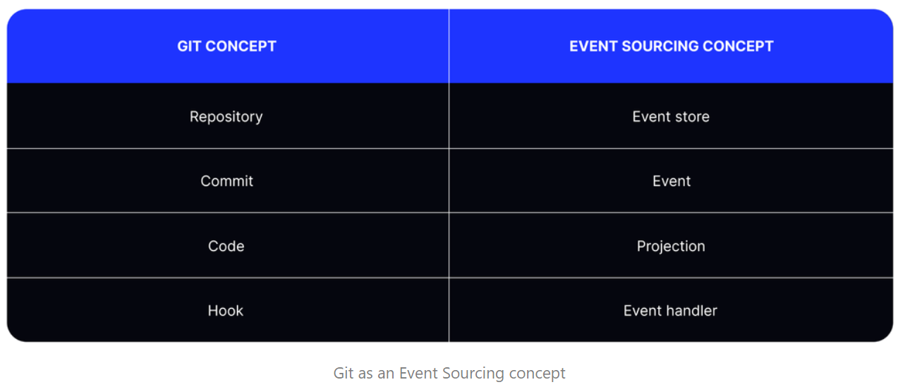
Why
EventStorming
Project "a CQRS Journey"
Notes:
traditional databases have for decades stored the “what,” or state of the business, Event Driven Architecture expands on this by adding the context — which is the “when,” “how” and “why” — providing new capabilities that are necessary for the future of data.
It makes it possible for enterprises to easily capture and communicate everything that happens in the business in the highest possible fidelity to a multitude of downstream use cases, including data analytics, application development, AI systems and LLM training.
Your data should reflect your business model, not the other way around, enabling businesses to integrate, analyze and respond to real-time events with historical context.
Moreover, explaining only Event Sourcing is usually not enough. DDD, CQRS, and the eventual consistency model model often go hand in hand with Event Sourcing. It's a very steep learning curve!
use Event Sourcing without CQRS?
While using Event Sourcing without CQRS is possible, it's often not very practical. We usually need to query data from multiple aggregates combined. Moreover, building custom query models by subscribing to produced events is relatively simple. Combining Event Sourcing and CQRS is like a pair of socks—you could go with one sock instead of two, but why on earth would you do that?
What is Event Sourcing?
Beginner's Guide to Event Sourcing | Kurrent

Slide 5
Notes:
Eliminate the traditional divide between event-oriented application logic and state-based data models.
Store application data in its native event format (capturing state and context) as well as stream highly curated operational or analytical data products directly to downstream interfaces.
Serving source data to large language models without requiring complex data preparation or vector databases.
Don’t lose resolution on data as it is moved, transformed, updated and reused in an effort to gain insight on the business, so no matter how many touches downstream systems have on the data, the business can always find its way to the original, native source of truth.
makes it possible to understand what happened in the business by replaying data backwards and forwards in time.
maintaining complete historical context while seamlessly handling real-time streams, hydrated complete, accurate data
An extremely interesting option of event sourcing is to be able to depict not only a reality, but also alternative realities. Since the calculated state depends on the interpretation of the individual events, events can be evaluated differently in retrospect. This also makes it possible to work with undo and redo steps,

Slide 6
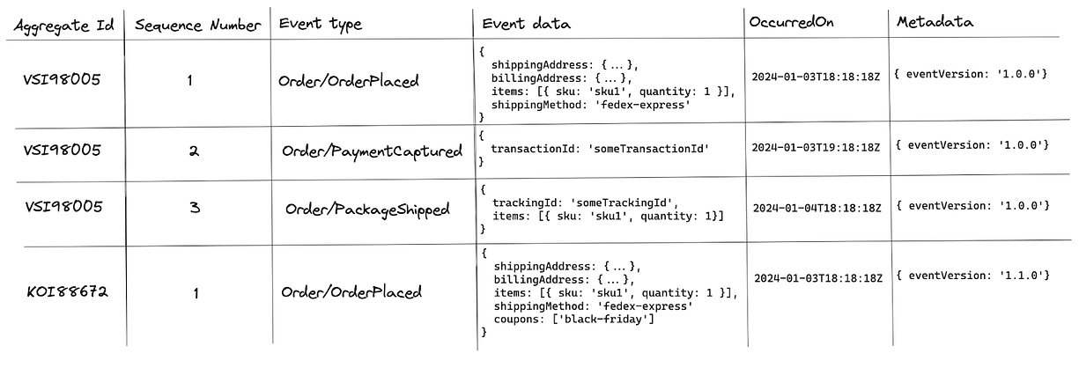
What Does an Event Look Like?
Notes:
Events should only contain the minimum amount of data, not the entire aggregate.
This means each of these events will capture different details.
It’s important to add some sort of unique domain name or namespace to the events.
This way, we can avoid name clashes between a package shipped for an order (Order.PackageShipped) and a package shipped for a stock transfer between 2 fulfillment centres (StockTransfer.PackageShipped).
1. Event Version
Event versions allow our system to grow and evolve over time.
2. Sequence Number
a number that increases by one for each new event in a single aggregate

Slide 7
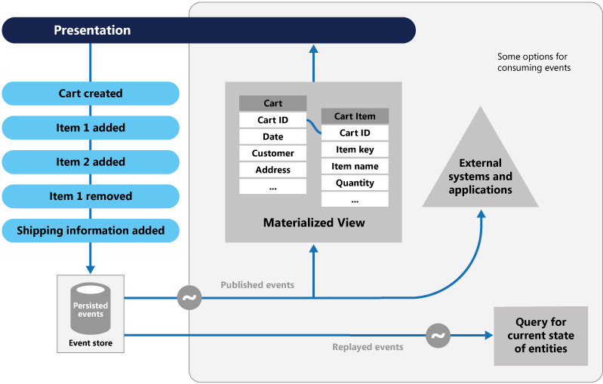
The event store is the permanent source of information, and so the event data should never be updated.
Notes:
Saving an event is a single operation, it is inherently atomic.
The application reconstructs an entity’s current state by replaying the events.
Applications persist events in an event store, which is a database of events.
The store has an API for adding and retrieving an entity’s events.
The event store also behaves like a message broker.
It provides an API that enables services to subscribe to events.
When a service saves an event in the event store, it is delivered to all interested subscribers.
Application state is stored as a sequence of events. Each event represents a set of changes to the data. The current state is constructed by replaying the events.
Pattern: Event sourcing

Slide 8
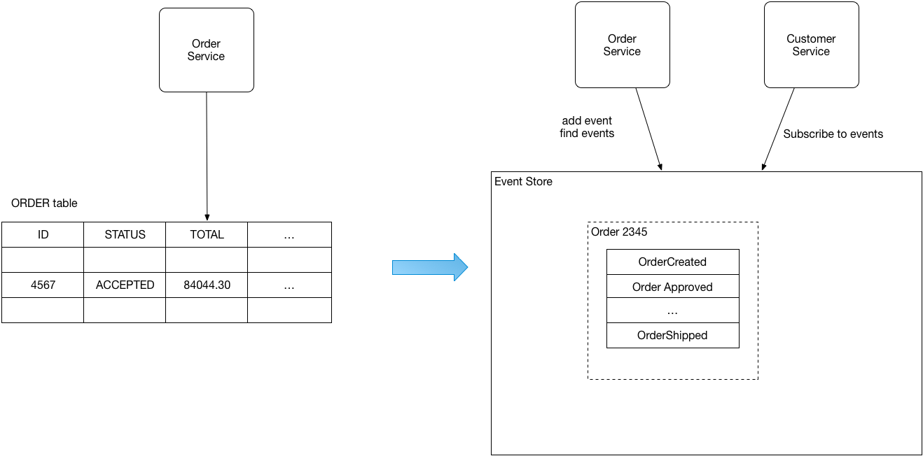

Slide 9
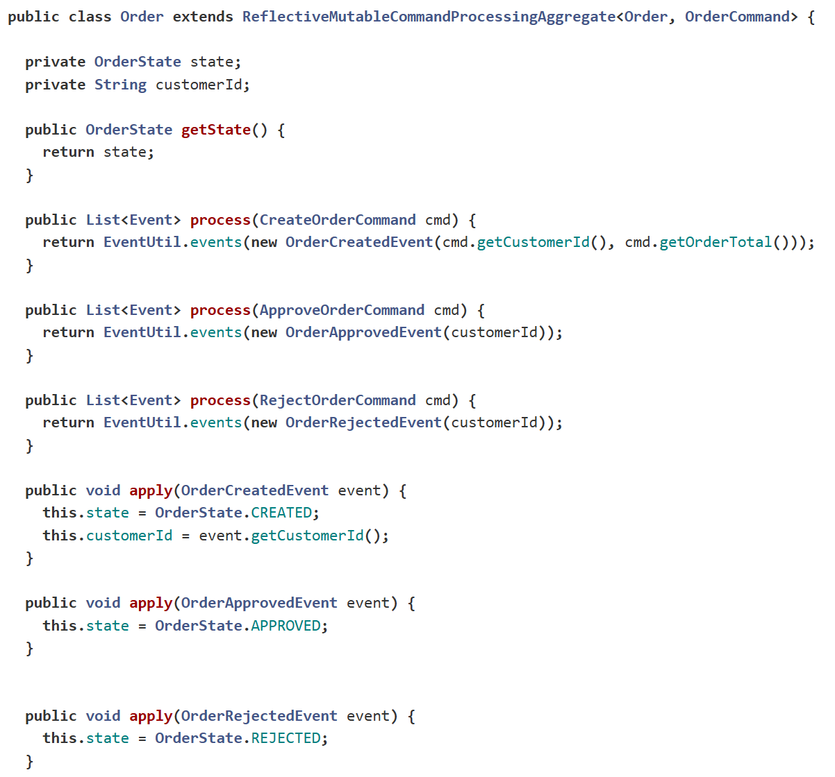
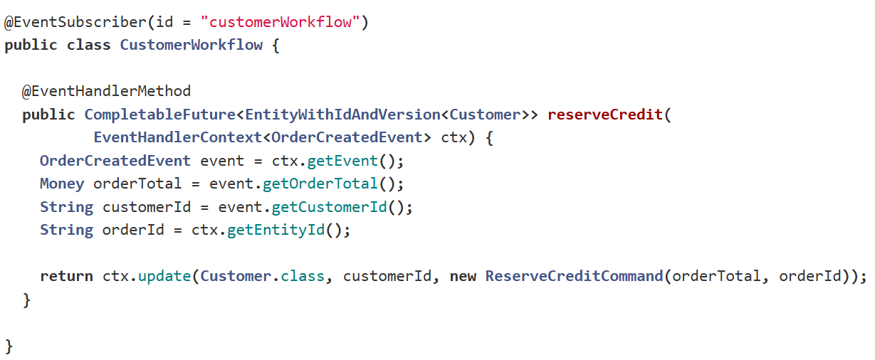
Order aggregate
Notes:
eventuate-examples/eventuate-examples-java-spring-todo-list: A Java and Spring Boot Todo list application built using Eventuate

Slide 10
Materialised View pattern
The data store used in a system that's based on event sourcing is typically not well suited to efficient querying.
Instead, a common approach is to generate prepopulated views of the data at regular intervals, or when the data changes.

Slide 11
Event-driven architecture (EDA)
You don’t store the final 'Row Value', result, Instead
Store all the steps 'Events' and apply 'Actions' to render the 'View'
Notes:
Event-driven architecture (EDA) is often considered the "holy grail" of system design.
Why? Because it enables asynchronous, decoupled, persistent, fault-tolerant, and scalable systems.

Slide 12
Architecture
Notes:
At its core, EDA architecture revolves around events—actions or occurrences that the system can react to.
It allows you to capture all changes to an application's state as a sequence of events.
This gives you a complete historical record of the application's state and lets you reconstruct any past state at any point in time.

Slide 13
Event Sourcing / Event Driven Architecture (EDA)
Notes:
Event-sourcing is a pattern that represents the state of an application as a series of events.
Instead of storing the current state of an object,
you store a log of events that have occurred,
which can be replayed to reconstruct the state at any given point in time.
Each event represents a discrete change in the application's state and is immutable.

Slide 14
Here’s the main idea behind event sourcing:
Notes:
In most applications, the state is typically represented as a row in a database that gets updated over time.
With event sourcing, we take a different approach.
So instead of just storing the value, we store the actions—everything that happens to that value.

Slide 15
Summary:
Notes:
"Don’t store the final result. Instead, store all the steps that led to that result.“
These actions, or events, are stored in the database in an append-only fashion.
This means we never go back and update past events, because each event reflects something that truly happened at a specific point in time.
If we later decide to reverse or correct an event, we don’t erase or alter the original event. Instead, we add a new "reversal" event.
This way, the original event remains part of the historical record.
After all, it did happen, and at the time, it was valid.

Slide 16
Now, let’s bring this concept to life with a relatable demo.
Notes:
Now, let’s bring this concept to life with a relatable demo.
Imagine opening your bank app and seeing a balance of $10.
That $10 didn’t just appear out of nowhere—it’s the result of a series of events:
You opened your account with a balance of $0.
Someone transferred $100 to you, so your balance became $100.
You spent $50 on something, leaving $50 in your account.
Then $10 was deposited, bringing your balance to $60.
Finally, $50 was withdrawn, leaving you with the current balance of $10.
Each of these actions—deposits, withdrawals, and even refunds—are events.
Your balance at any moment is simply the result of all these events added together.
If you need to reverse an event, like getting a refund for a purchase, you don’t erase the original event.
Instead, you add a new event to reflect the refund. By summing up all the events from the starting balance, you always arrive at the current state.
**This process may seem inefficient at first, especially if we were to recount every event each time we needed the balance.
In real-world systems, there are optimizations to avoid recalculating everything repeatedly,
but the fundamental principle remains:
state is built from events.

Slide 17
Walkthrough of event sourcing
Notes:
A walkthrough of event sourcing, its practical implementation, and how to efficiently manage state through projections.
Here's a summarized breakdown of the key points for better clarity:

Slide 18
1. Event Sourcing Basics
What It Is: Captures all changes (events) to an entity (e.g., a student) in a sequence.
Why It Matters:
Maintains a full history of changes (audit trail).
Allows rebuilding the state of an entity from its event stream.
Core Components:
Event Stream: A collection of events for a specific entity (e.g., "Student Created", "Student Enrolled").
Apply Methods: Specific methods in the entity class to apply changes from each event.

Slide 19
2. Materialising State
On-the-Fly Materialisation:
Dynamically rebuilds the entity's state by replaying events in the correct order.
Example: Rebuilding a Student object by sequentially applying StudentCreated, StudentEnrolled, and StudentUpdated.
Projections:
Stores the latest state (materialized view) to avoid rebuilding every time.
Synchronous Projection: Updates the projection immediately as events are appended (requires transactional support).
Asynchronous Projection: Updates projections asynchronously using mechanisms like change data capture (CDC).

Slide 20
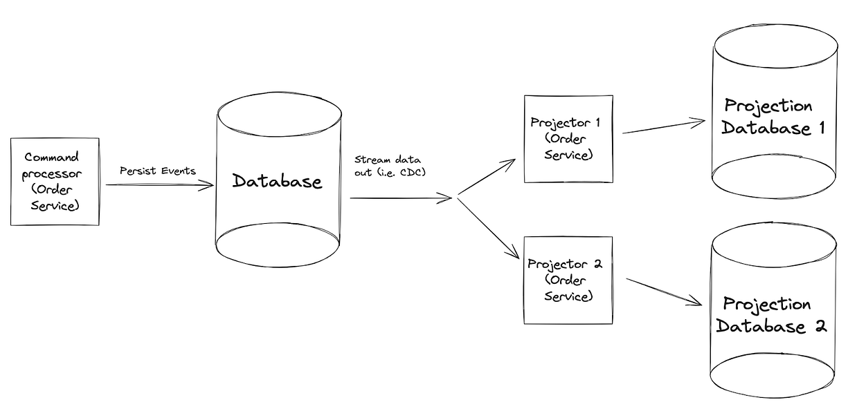
3. Synchronous Projection with Transactions
Atomicity: Ensures appending an event and updating the projection happen together or not at all.
Implementation in DynamoDB:
Use TransactWriteItems to store both:
The event in the event stream.
The updated projection (current state) in the database.
Notes:
A projection is a representation of the data in a different format.
serves two main purposes:
Analyzing your data (an OLAP system), such as viewing all orders placed between dates X & Y, with at least 2 items but no more than 5, and a subtotal of $500 to $600.
Providing eventually-consistent data for the customer that is optimized for the use case(s), like pre-computing complicated or expensive queries that are often needed.
To build these projections, the database events are extracted, using for example change data capture (CDC), and streamed

Slide 21
4. Asynchronous Projection
How It Works:
Relies on DB's streams (change notifications) to trigger updates to projections.
A Lambda function can process these stream records to update the projection asynchronously.
Advantages:
Suitable for read-heavy scenarios where eventual consistency is acceptable.
Allows decoupling projections from the event storage system.

Slide 22
Create a simple way to rebuild projections
— Projections aren’t the source of truth. They are meant to be entirely replaceable if the needs change. Being able to rebuild projections (i.e. in a new database instance) can be useful if your projection becomes outdated or broken for some reason. Ideally, you only want to build a new projector, create an empty projection, then run a CI/CD pipeline which will re-emit all historical events to this new projector.
Notes:
what is the minimum amount of information that needs to be persisted

Slide 23
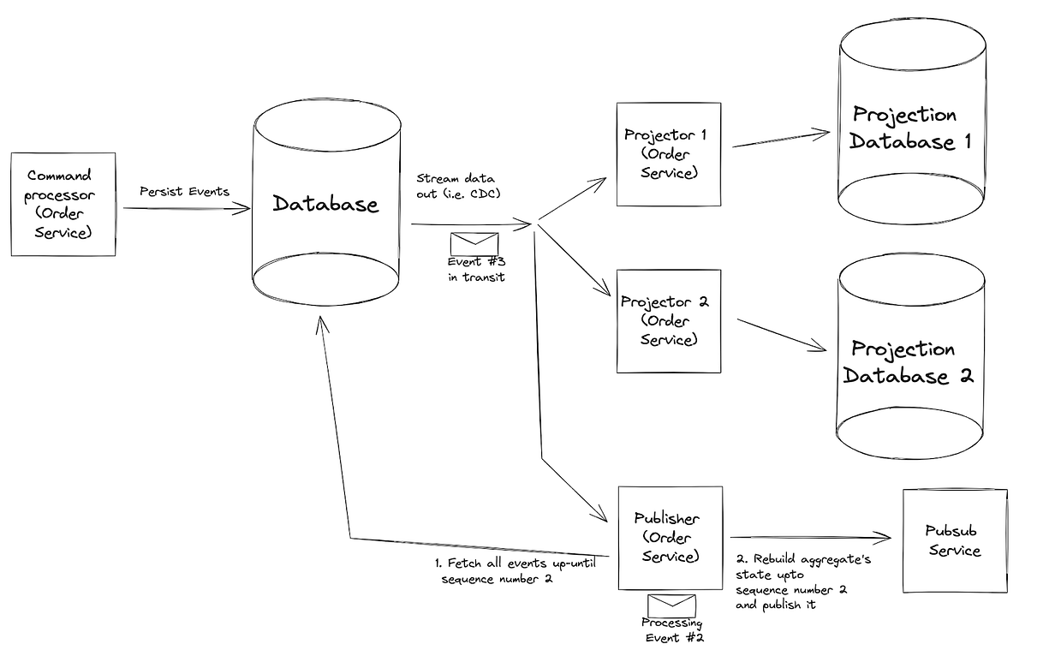
Publish Events
sequence numbers in order to be able to rebuild the aggregate at that specific point in time.
Sequence numbers can prevent race conditions when publishing your aggregates while there are in-flight events.
Notes:
Publish Events

Slide 24
5. Key Considerations
Efficiency: On-the-fly materialization can be costly if the event stream grows large.
Flexibility: You can recalculate projections for new use cases without altering the event stream.
Consistency Needs:
Strong Consistency: Use synchronous projections with transactional updates.
Eventual Consistency: Use asynchronous projections with CDC.

Slide 25
6. Benefits of Event Sourcing
Full historical data (auditability).
Ability to reconstruct state at any point in time.
Flexibility to adapt to changing requirements without data loss.

Slide 26
Final Thoughts
Event sourcing paired with projections offers a robust way to manage state and handle changes.
The choice between synchronous and asynchronous projections depends on your application’s consistency, performance, and scalability requirements.
Notes:
https://learn.microsoft.com/en-us/azure/architecture/patterns

Slide 27
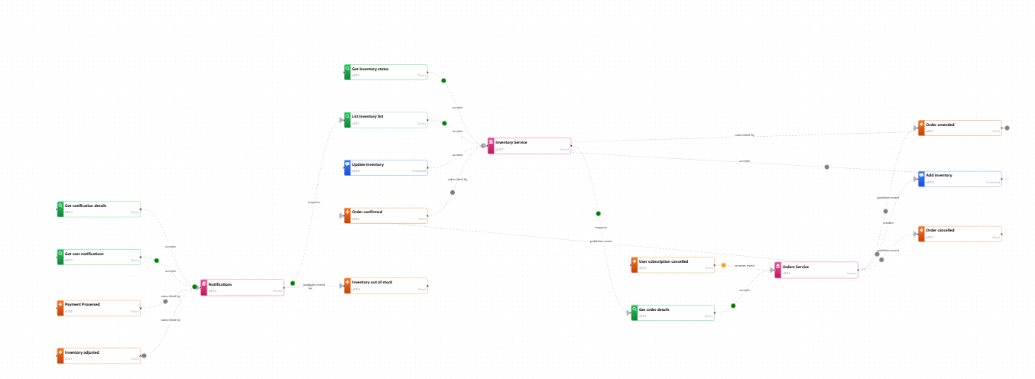
Event Catalog
Demo EventCatalog | Domains | Orders Discover and document your event-driven architecture effortlessly.
Notes:
EventCatalog uses MDX under the hood. This gives you the ability to include predefined components inside your contents.
You can add components to your domains, services or messages.
Using components - EventCatalog

Slide 28
EventCatalog Integrations - EventCatalog
Download Modeling SDK for Microsoft Visual Studio 2015 from Official Microsoft Download Center
An entire solution built into VS, which focuses largely on building your with Visual Studio's design tools over code. It comes with a minimum language starter template to help you.
Microsoft Visual Studio 2012 Visualization & Modeling SDK
Microsoft Visual Studio 2010 Visualization & Modeling SDK

Slide 29
Getting Started with Modelling SDK ( DSL in Visual Studio 2017) – YouTube
Supported Visual Studio Editions for Visualization and Modeling SDK | Microsoft Learn
Use models in your development process - Visual Studio (Windows) | Microsoft Learn

Slide 30
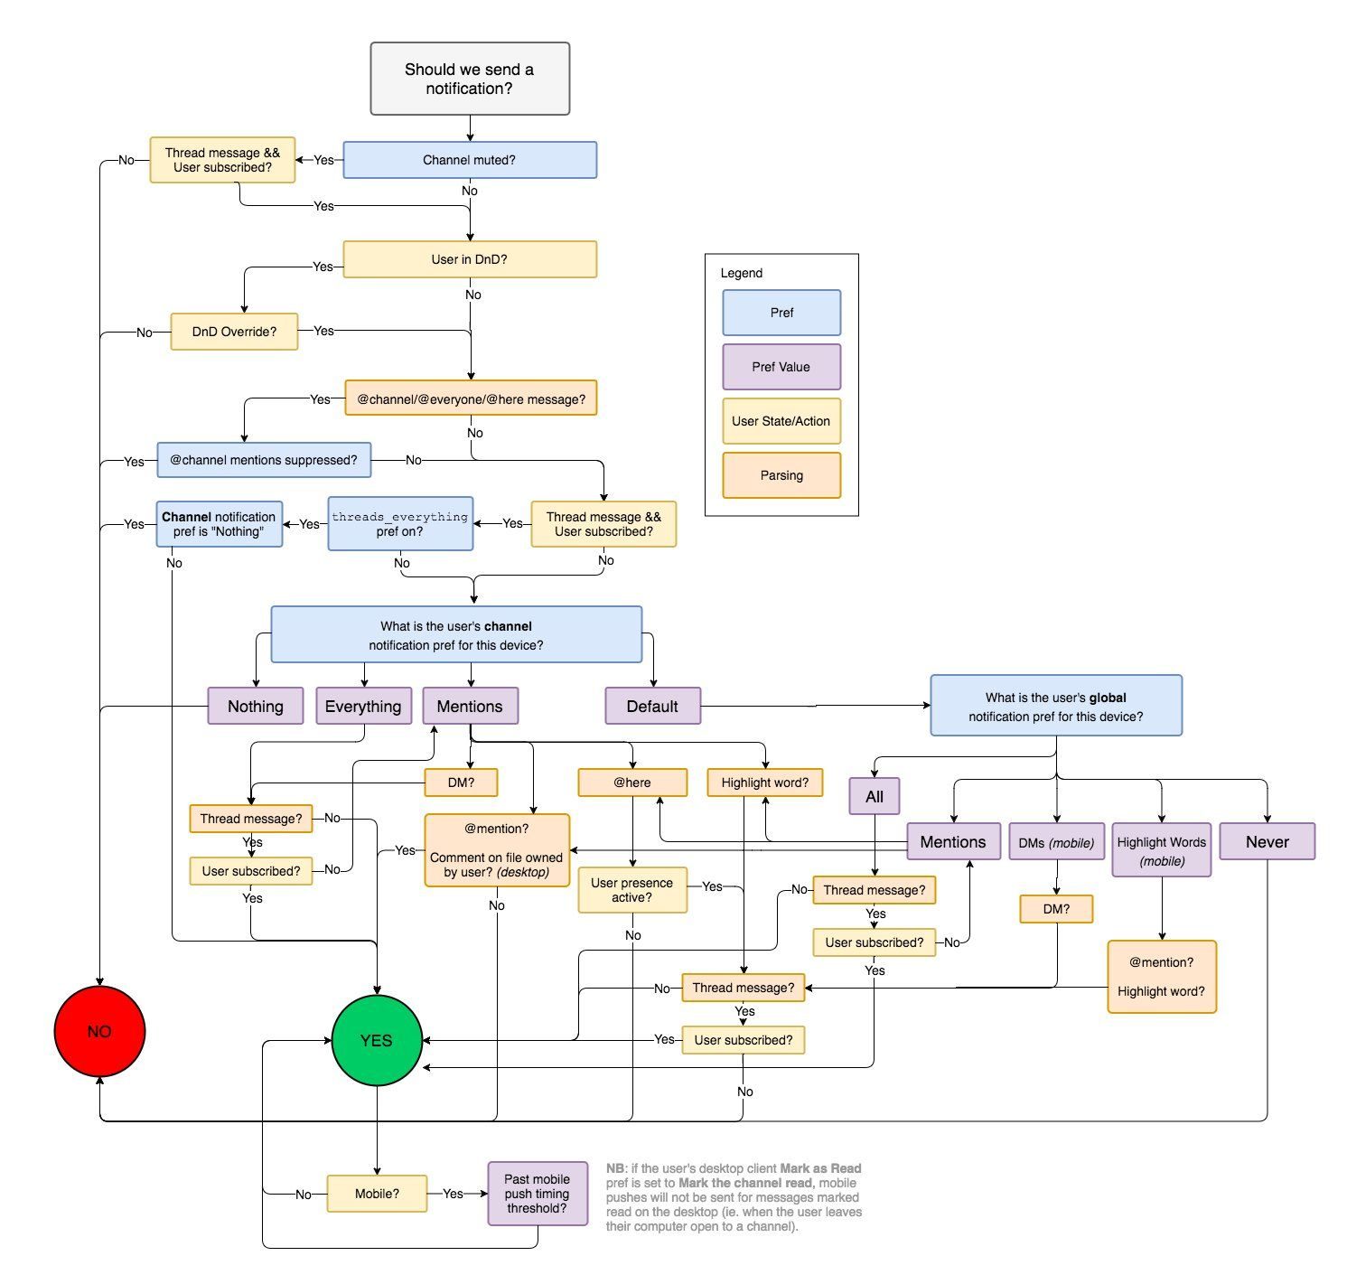
Event Sourcing is a fascinating design pattern. In an Event Sourced applications/systems instead of storing the current state we derived the current state from a list of event

Slide 31
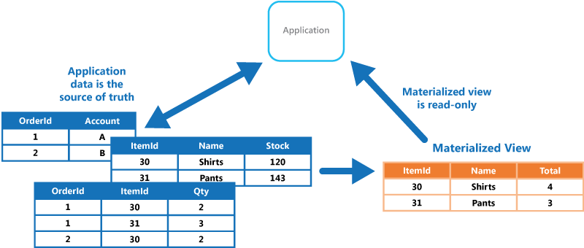
Notes:
In a cloud-based system that implements horizontal scaling, multiple instances of the same task could be running at the same time with each instance serving a different user. If these instances write to a shared resource, it's necessary to coordinate their actions to prevent each instance from overwriting the changes made by the others.
If the tasks are performing individual elements of a complex calculation in parallel, the results need to be aggregated when they all complete.

Slide 32
Web API – A Backend for Frontends
Expose endpoints that allow client applications to call their APIs.
The code used to implement the APIs triggers or performs several tasks, including but not limited to
authentication,
authorization,
parameter validation, and
some or all request processing.
The API code is likely to access storage and other services on behalf of the client.

Slide 33
communicate by using HTTP-based web services. However, this approach has drawbacks, including:
The systems must be modified by adding an HTTP client on one side and an HTTP request handler on the other. The systems must then be retested and redeployed.
HTTP endpoints must be hosted, which adds complexity when you make web services secure and highly available.
Frequent network connectivity problems that require custom-built retry mechanisms.

